Slide 1



The Modern Resume
Building Your Brand
Steve Jones
Editor, SQLServerCentral
Red Gate Software
SQL Share

Slide 2
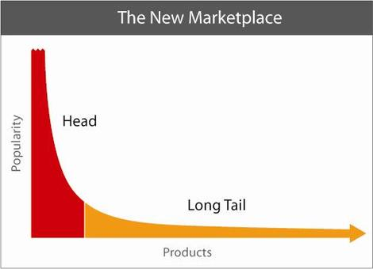



Long Tail
Desire to Hire
Potential Employees
Notes:
Has anyone read The Long Tail? Do you know what it is? There’s this idea of niches that have value. The common example is in music. Few artists are at the head (U2, Rolling Stones, Taylor Swift), and most are further down. Many are at the tale, like the one-hit wonders, or those that never have a hit.
(click)
You are a niche for your next job, or you should be. You can strive to be at the head, or the tail. The head is more attractive in the marketplace. Kalen Delaney is up here. She likely gets any job she finds. Bill Graziano is in the middle, he’s a well known consultant, and would be someone that you would have to compete against. The rest of us are further down the tail. However with a little effort you can move up the tail or…
Next – Wheat/Chaff

Slide 3


Notes:
Know what this is? Wheat and chaff. When you harvest, you get everything, but then you need to separate things out and get the grain. Get what you want. You want to get separated for the position that is right for you, or that you want.
In other words – (Next umbrella)

Slide 4

Notes:
Stand out of the crowd.
Next – How to stand out

Slide 5
How to stand out?
Profiles
Volunteer
Research
Be a Leader
Blog
Publish
Speak
Can be Internal or External
Notes:
Various ways, important thing (Click) these can be external or internal to your job. External meaning out in public, internal, behind the firewall.
Next - Caution

Slide 6

Notes:
Be careful as you move forward (next CareerBuilder)

Slide 7
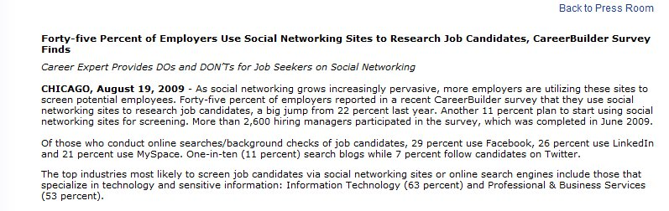
Notes:
People will look for you online. There was a survey from Careerbuilder that showed 45% of employers use social networks to check candidates. This is up from 33% a couple years ago (next trip ups)

Slide 8

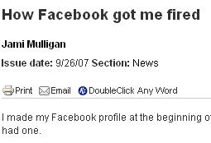
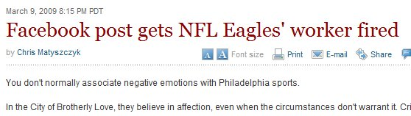
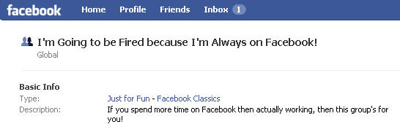
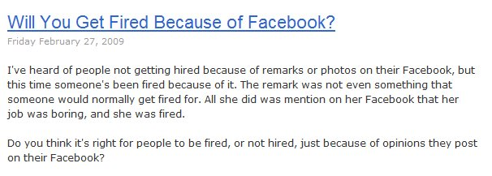
Notes:
Some examples of bad profiles
Emabaress MS, get fired (picture of Mac on loading dock)
Too much time on networking
(click) Concept of privacy
It’s not big brother, it’s older brother.
(next Image is Everything)

Slide 9
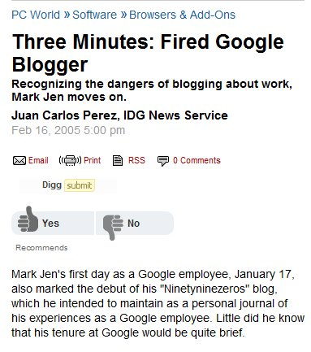

Notes:
Mark Jen, fired a week after being at google for blogging on his job. At the time Google was very private.
A blogger dismissed from Microsoft. What did he do? (next slide)

Slide 10
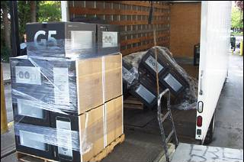
Notes:
Posted pictures of Macs. Nothing big here, but this cost him his job.

Slide 11
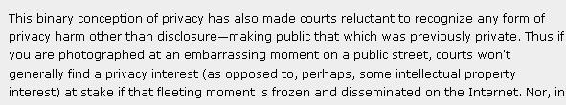
Courts won’t generally find a privacy interest
Notes:
Be careful what you post. This is from a law journal.

Slide 12
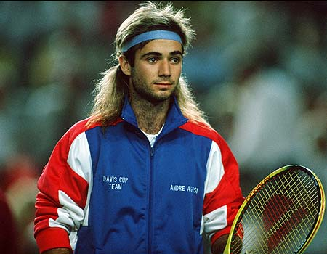
Image is Everything
Not Everything, but it does matter
Notes:
Image isn’t everything, but it is important. Especially when looking for a job.
Next – online profiles

Slide 13






Social Networking
Notes:
There are a lot of networks out there.
Next - Authors

Slide 14
Online Profiles
Web 2.0 / Social Networking
No different from the real world
  Chamber of commerce
  User groups
  BBB
In today’s world, the online world can take the place of these offline events.
Notes:
Building an online profile is a no different than things done in the past in the real world. Chamber of Commerce or BB meetings, user groups, other business associations, all had happy hours or other ways for people to connect with each other, get to know each other professionally, and create opportunities.
This is the modern “golf course”

Slide 15
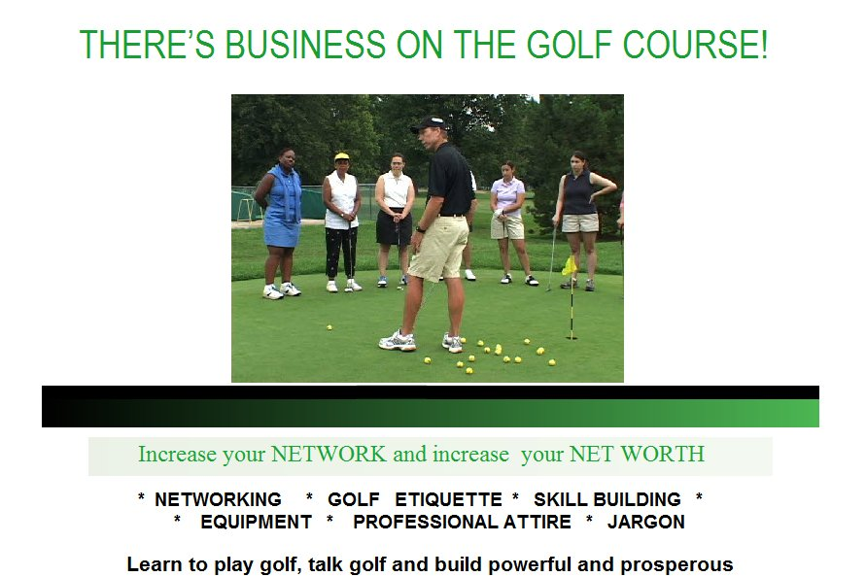
Notes:
This is the modern golf course. How many deals have puzzled you in business? How many times have you suggested that your boss chose a vendor over a game of golf, a dinner, or some other event. Business is involved with relationships between people. Social networking can help you expand those reaches.

Slide 16
Online Profiles
A way to network with other professionals
A way to let others know about you
  What you are engaged in
  Your current status
A way to hear about
  Opportunities
Notes:
Building an online profile is a no different than things done in the past in the real world. Chamber of Commerce or BB meetings, user groups, other business associations, all had happy hours or other ways for people to connect with each other, get to know each other professionally, and create opportunities.
This is the modern “golf course”

Slide 17
Online Profiles
Building an online profile
  Facebook
  LinkedIn
  Plaxo
  MySpace
  Twitter
  Blogger/Wordpad/Typepress/?
  ?
Use an email that you can monitor.
Update this on a regular basis
  Every 2-4 weeks
Get email updates on a reasonable schedule
Notes:
Doesn’t matter where you put one. Pick a place, or multiple places
Use an email that you monitor so people can find you if they have an opportunity. Or you send out a resume. Never know how they might contact you.
Update your status periodically. Show people that you are doing something in your career.

Slide 18
Online Profiles
Give “them” one
  They’ll find one anyway
Be prepared to explain any you have created
  And maybe some you haven’t
  Example coming up
Be professional
  You can have fun, but keep it separate
  ALL your actions reflect on you, remember that.
  Use “THE Test”
Notes:
CareerBuilder says 22% of hiring managers search for an online profile.
You want to manage your profile. Not lie, but disclose and show yourself off. (pager story)
Anyone can create one for you. Watch for your profile online. Especially if you have had issues. Don’t create one.
Washington Post or Kids test. If you wouldn’t want them to see it, don’t put it up there.
Next - Leadership

Slide 19
Online Profiles
Avoid identity information
  Check with your family
Keep this profile professional
  Create a 2nd one for personal information
Notes:
Be careful what you post. Check with family, especially for address/identity info.
If you want a profile for your life, make it separate. Let this one be for professional posts only.
Next - volunteer

Slide 20
Volunteer
PASS/Local Group
  Be sincere
  Be sure your name is out there
  Document efforts
Work
  Tackle something that needs to be done
  Be sure this is noted somewhere, like the intranet, company newsletter, etc.
Notes:
There are a number of places you can volunteer. It takes time, but it is a way to expand your career and show another side to you.
Helping PASS or your User group can build great networking opportunities, and it shows your brand to the SQL community.
Volunteering at work can help you raise your profile. It shows initiative, independent work, and caring.

Slide 21
Volunteer
Forums
  Help others by answering questions
  Pay it forward
  Force yourself to learn more/check yourself
Notes:
You can also help in forums.

Slide 22
Research
Ask questions your online
  Can be added to your blog
  Show some back story, thought process, some effort being made
  Shows you are learning and unafraid to ask for help.
  Shows that you know how to find help
Notes:
Ask your own questions online. As you learn something, put it back out there. Give the back story, the why, the how, the what you learned, or the how it helped you.
This shows you are working on your own career and knowledge. Both to your current boss and potential future ones.
Next - Documentation

Slide 23
Leadership
Everyone needs leaders
Leader != Manager
  But it helps
You can be
  Project leader
  Organization leader
  Thought leader
This does not have to be in technology!
Notes:
Leadership helps you stand out.
This is not a manager, though it can be. And that helps.
Project leader – On some task, provide coordination, direction, ideas
Organization – Can be internal or external, formal or informal.
Thought – Just express yourself. You can be someone that people follow, or maybe counsel
Leadership skills can be shown outside of your job or technology. Boy Scouts, church, a book club, a volunteer organization, it all counts.
Next - blogging

Slide 24
Blogging
A chronicle
This is a your voice
Write about what you
  Learn
  Know
  Solve
  Do
  Think
Notes:
Blogging should be about you. It’s what you do in your career. Write about what happens to you.

Slide 25
Blogging
Don’t overthink it.
Tackle small, discrete items
Ignore similar posts
Remember this is about YOU!
A long term chronicle of your career.
Keep this blog professional
  Relate it to your career
Notes:
Examples: backups fail, trying to explain why log restores needed.
Issues with working over the phone
disconnect with developers, manager
Going to work late, after hours
Organization of files
impact to organization, what I could minimize in the future.
Building a Report
Request comes in, how you analyze the request and get more information
Structuring this report to meet needs, decisions taken
Writing queries, simple, complex, how the query translates into the business need, planning for future changes, tuning, looking at indexes
New Report
New person? How are they different. Same person, has it gotten better
Checking for similar reports, looking for reuse
New tools/features
Next - Publishing

Slide 26
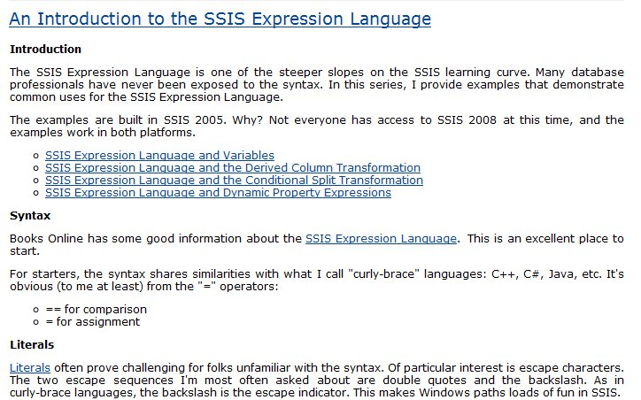
Example
Notes:
A good one, though a little long.

Slide 27
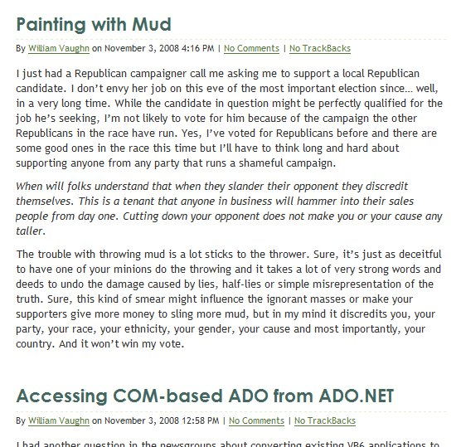
A Mistake
Politics
Development

Slide 28
How to blog
Get Permission
Be smart
  Don’t disclose financial information
  Keep company secrets secret
Be consistent
  Pipeline and schedule
  Be clear
  A survey of hiring managers showed they tend to look at 5-10 posts.
Notes:
Ask your boss, set rules, keep it simple
Don’t do anything that you wouldn’t want done to you
Get ahead of the curve and make this a regular occurrence. Choose a reasonable schedule. I’d say once every other week at a minimum, set reminders in Outlook.
If you have nothing interesting, write that. IF that happens too often, think about that as well. Time for a new job
Imagine you’re writing for a jr DBA or new guy in your position, explain things clearly. Don’t assume too much (may vary for internal blogging)
Big internal bloggers: Andy Grove – Intel,
Next – Blogging Ideas

Slide 29
How to blog
Don’t copy other posts
Don’t copy other posts
Don’t copy other posts
Do your own research
Link to others and give credit
Keep a record
  Use Blogger/Word Press/Typepad
Live Writer is great
Notes:
Ask your boss, set rules, keep it simple
Don’t do anything that you wouldn’t want done to you
Get ahead of the curve and make this a regular occurrence. Choose a reasonable schedule. I’d say once every other week at a minimum, set reminders in Outlook.
If you have nothing interesting, write that. IF that happens too often, think about that as well. Time for a new job
Imagine you’re writing for a jr or new guy in your position, explain things clearly. Don’t assume too much (may vary for internal blogging)
Big internal bloggers: Andy Grove – Intel,
Next – Blogging Ideas

Slide 30
Authoring / Publishing
Become a teacher
Think “Essay”
  Focus, focus, focus
Don’t be intimidated
Notes:
1 - Print is still good, and it’s exciting, but it’s not necessary. Big time investment, more of a “head of the tail” not “Tail of the tail” idea.
Lulu – Vanity if you really want to)
2 - As you try to write online, think of writing an essay
Focus on one thing. Don’t try to solve all issues. Don’t get carried away with setup. Andy as example
3 - If you’ve solved it, there might be 1,000 people that have, but likely 5,000 that haven’t.
You are teaching here, more focused than blogging.
Next - Volunteer

Slide 31
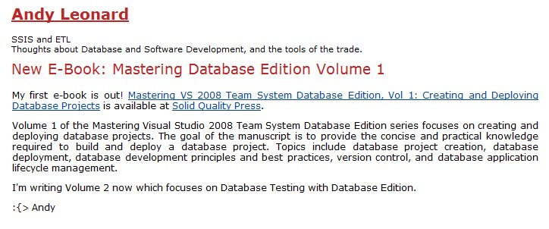
Books
Long projects
Lots of authors subcontract out
  Social networking can help you find these
Promote it
Notes:
Books are longer projects, but they are a great way to show off your skills.

Slide 32
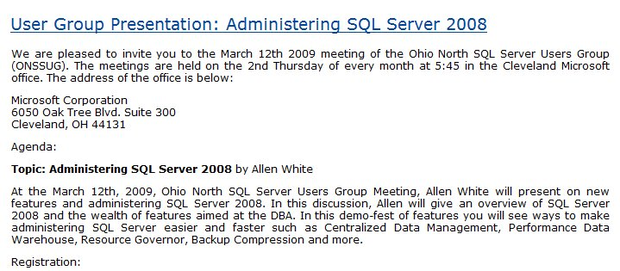
Speaking
Offline efforts
Promote it online
  Market on your blog (or others)
  Support with downloads
  Make sure there is a permanent URL
Notes:
Speaking helps you network, and it’s another way of sharing knowledge. User groups, PASS, many opportunities.

Slide 33

Documentation
Document everything.
  Never know when you’ll need something
Don’t clutter your resume
  But have links available
  Or have an online CV
Document mistakes
  Let them know you’re not that guy:
Notes:
1 – keep track of what you do. Use Gmail/Hotmail, forward your blogs. Know what you’ve done. It helps you track your data shadow. Know what you wish you hadn’t as well.
2 – Keep your resume simple. Even in this day of electronics, go with 2 pages, no more. After 2-3 jobs, summarize to 2 lines, link to other things. A CV, complete history isn’t a bad idea.
3 – Find out what is wrong in your data shadow. Know what’s out there and have a reason, admit mistakes (know what you learned) and also be sure you know where confusion lies.
The “guy” is Steve Jones, Sex Pistols. Not me.
Next – End

Slide 34

The End
Touch your resume every quarter
Good Luck
Questions?
Career Forums at www.sqlservercentral.com/forums
www.themodernresume.com

Slide 35



Brad McGehee’s
SQL Server Stumpers
"You can have an unlimited number of clustered indexes on a table."
True or False?

Slide 36


Did you know?
"SQL Compare can find differences between your source control scripts and a live database. "
Elliot Matthew Red Gate Software

Slide 37
Brad McGehee’s
SQL Server Stumpers
"You can have an unlimited number of clustered indexes on a table."
False!

Slide 38


The Exceptional DBA
Awards
"The awards will give an exceptional DBA some much-deserved recognition and help to increase the awareness of the importance of the DBA role among the IT community."
Brad McGehee Exceptional DBA Awards Judge
SPONSORED BY

Slide 39
Brad McGehee’s
SQL Server Stumpers
"If the SQL Server Browser Service is not running, you cannot connect to a named instance by name."
True or False?

Slide 40


Did you know?
"Network resilience in SQL Backup Pro lets you create robust and resilient backups by resuming backup operations that have been interrupted by network outages."
Nigel Morse Red Gate Software

Slide 41
Brad McGehee’s
SQL Server Stumpers
"If the SQL Server Browser Service is not running, you cannot connect to a named instance by name."
True!

Slide 42

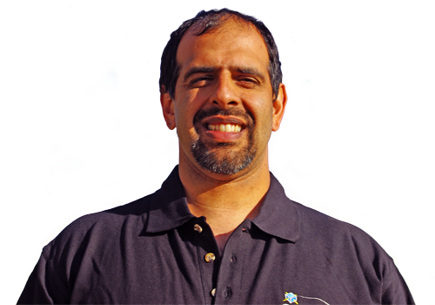
Did you know?
SQL Server Central has highly active forums, where you can get a response to a question on SQL Server and other topics in a matter of minutes.

Slide 43
Brad McGehee’s
SQL Server Stumpers
"A full database backup truncates the log when the database recovery mode is set to FULL or BULK LOGGED."
True or False?

Slide 44


Did you know?
"SQL Response sends you alerts and recommendations about the health and activity of your SQL Servers, so you can work proactively to minimize problems."
David Connell Red Gate Software

Slide 45
Brad McGehee’s
SQL Server Stumpers
"A full database backup truncates the log when the database recovery mode is set to FULL or BULK LOGGED."
False!

Slide 46


Did you know?
Simple-Talk.com has a wealth of articles written by industry experts on SQL Server, .NET and SysAdmin, with no registration required to access each article.

Slide 47
Brad McGehee’s
SQL Server Stumpers
"After updating the fragmentation of an index using ALTER INDEX REBUILD you don't need to update the statistics."
True or False?

Slide 48


Did you know?
"SQL Prompt simply sits behind the scenes and provides unobtrusive help when you press CTRL+SPACEBAR or when you type "." after a table/view/alias name. "
Simon Galbraith Red Gate Software

Slide 49
Brad McGehee’s
SQL Server Stumpers
"After updating the fragmentation of an index using ALTER INDEX REBUILD you don't need to update the statistics."
True!

Slide 50
Did you know?
"SQL Compare can find differences between your source control scripts and a live database. "
Elliot Matthew Red Gate Software

Slide 51
Brad McGehee’s
SQL Server Stumpers
"SQL Server automatically creates statistics on an index and it is impossible to turn that feature off."
True or False?

Slide 52


Did you know?
"The Outlook Add-ins for Exchange Server Archiver deliver a truly 100% transparent
end-user experience "
Chris Bacon Red Gate Software

Slide 53
Brad McGehee’s
SQL Server Stumpers
"SQL Server automatically creates statistics on an index and it is impossible to turn that feature off."
True!

Slide 54
Did you know?
"Network resilience in SQL Backup Pro lets you create robust and resilient backups by resuming backup operations that have been interrupted by network outages."
Nigel Morse Red Gate Software

Slide 55
Brad McGehee’s
SQL Server Stumpers
“Certificates can be used to only encrypt other keys (symmetric or asymmetric).
True or False?

Slide 56


Did you know?
"ANTS Performance Profiler shows you line-level code timings, so you can drill down to the specific lines of code responsible for performance inefficiencies. "
Bart Read Red Gate Software

Slide 57
Brad McGehee’s
SQL Server Stumpers
“Certificates can be used to encrypt data or other keys."
False!

Slide 58
Did you know?
SQL Server Central has highly active forums, where you can get a response to a question on SQL Server and other topics in a matter of minutes.

Slide 59
Brad McGehee’s
SQL Server Stumpers
“In SQL Server 2008, you can mirror a database set to compatibility mode 90.”
True or False?

Slide 60
The Exceptional DBA
Awards
"The awards will give an exceptional DBA some much-deserved recognition and help to increase the awareness of the importance of the DBA role among the IT community."
Brad McGehee Exceptional DBA Awards Judge
SPONSORED BY

Slide 61
Brad McGehee’s
SQL Server Stumpers
“Database Mirroring does not check the compatibility mode. It will mirror a database at any level."
True!

Slide 62
Did you know?
Simple-Talk.com has a wealth of articles written by industry experts on SQL Server, .NET and SysAdmin, with no registration required to access each article.

Slide 63
Brad McGehee’s
SQL Server Stumpers
“All page types can be restored with the single page restore option.”
True or False?

Slide 64
Did you know?
"SQL Compare can find differences between your source control scripts and a live database. "
Elliot Matthew Red Gate Software

Slide 65
Brad McGehee’s
SQL Server Stumpers
“While data pages can be restored with the single page restore feature, the file header pages, boot page, GAM, SGAM, Diff map and ML maps cannot be restored."
False!

Slide 66
The Exceptional DBA
Awards
"The awards will give an exceptional DBA some much-deserved recognition and help to increase the awareness of the importance of the DBA role among the IT community."
Brad McGehee Exceptional DBA Awards Judge
SPONSORED BY

Slide 67
Brad McGehee’s
SQL Server Stumpers
“SELECT 6 | 7 returns 7.”
True or False?

Slide 68
Did you know?
"ANTS Performance Profiler shows you line-level code timings, so you can drill down to the specific lines of code responsible for performance inefficiencies. "
Bart Read Red Gate Software

Slide 69
Brad McGehee’s
SQL Server Stumpers
“SELECT 6 | 7 is an inclusive OR operation, which will return 7.
6 = 0110
7 = 0111
The OR result is 0111.”
"
True!

Slide 70
The Exceptional DBA
Awards
"The awards will give an exceptional DBA some much-deserved recognition and help to increase the awareness of the importance of the DBA role among the IT community."
Brad McGehee Exceptional DBA Awards Judge
SPONSORED BY

